Slide 1
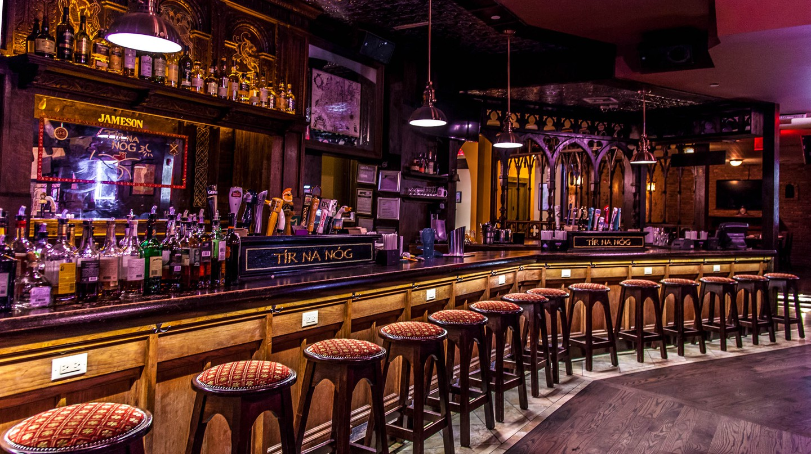
Welcome to Beer Gourmet

Slide 2
Elevator Pitch
Team Introduction:
Jenry Valdes
Nicholas Luberda
Kimberley Heuer
Tracy Golden
Beer Gourmet is the home for those wanting to discover great beer and food pairings

Slide 3
Concept – User Stories
User Story 1:
As a casual beer drinker,
I want to search for different types of beer by clicking on the different beer options in the sidebar under “Hoppiness!” or “Flavour!”,
So that I can read a short description of each beer to learn more about the different types and find new beers to try.
Acceptance Criteria:
I know I am done when different beer options appear along with a description after clicking one of the beer type options in the sidebar.

Slide 4
Concept – User Stories (continued…)
User Story 2:
As a seasoned beer drinker AND a big-time foodie,
I want to search for different beer and food pairing choices (depending on the type of beer selected) by clicking on the different beer options in the sidebar under “Hoppiness!” or “Flavour!”,
So that I can see which food options go along with which type of beer and then obtain restaurant suggestions based on those particular food pairings.
Acceptance Criteria:
I know I am done when different beer options appear alongside food pairing options AND restaurant suggestions are provided after clicking one of the food pairing options.

Slide 5
Concept - Motivation for Deployment
Motivation for Deployment (listed in order):
Looking for 2 robust API’s
An essential guide where people can learn about different types of beer and food pairings
A simple, user-friendly and clean application

Slide 6
Process
Technologies Used
Visual Studio Code
Slack
GitHub
Foundation (website template)
Balsamiq (wireframe)
APIs Used
Punk (beer)
Spoonacular (food)
Breakdown of tasks and roles:
Front-End:
Jenry Valdes
Nicholas Luberda
Back-End:
Kimberley Heuer
Tracy Golden

Slide 7
Process (continued…)
Some of the challenges we encountered:
Quality, number and variety of image results from selected APIs
Exiting from the modal had an overlay issue
First time using GitHub within a group
Limited search functionality through Punk API
Our successes:
Selecting the overall website template
Added fun beer and cutlery icons to the sidebar and modal
Getting our 2 APIs to work together
Team communication/collaboration – we worked really well together!

Slide 8
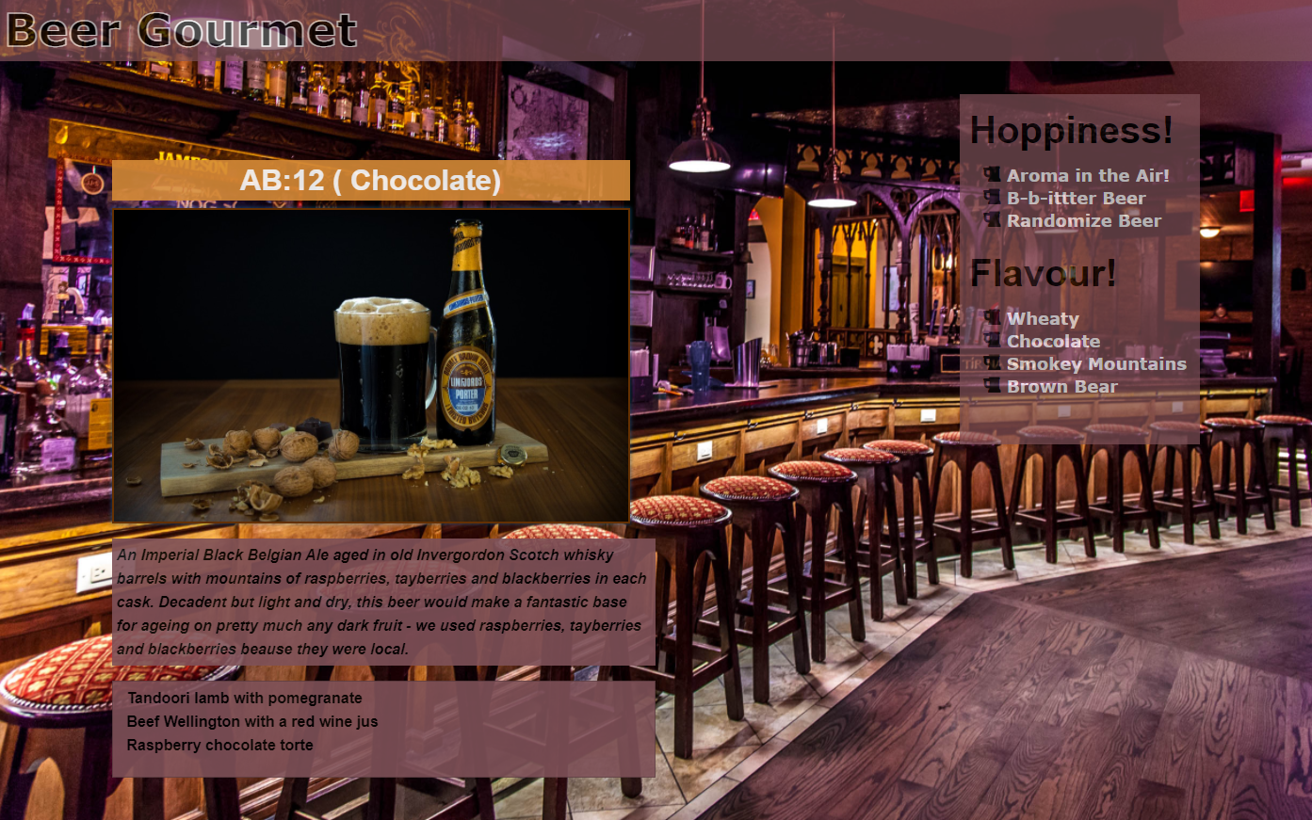
Demo

Slide 9
Directions for Future Development
Connecting more APIs such as:
Geolocation
Travel Ideas offering beer-hopping trails

Slide 10
Links to the Deployed Application and the GitHub Repository
Deployed Application: https://jenryval.github.io/Beer-Gourmet/
GitHub Repository: https://github.com/jenryval/Beer-Gourmet

Slide 11
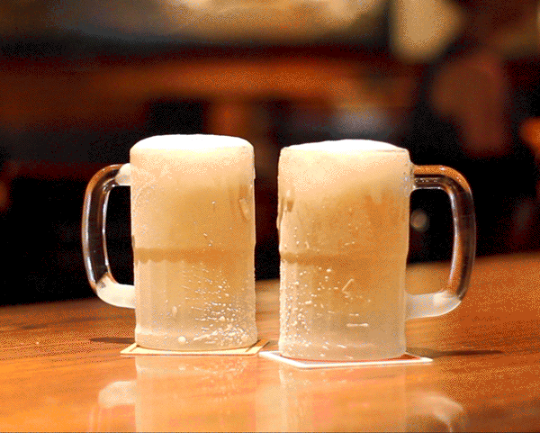
Thank You…and Cheers!

